Slide 1

Prediction of diabetes using Logistic Regression Project by - Nishad Chaoji

Slide 2
What exactly is Diabetes
Diabetes is a disease that occurs when your blood glucose, also called blood sugar, is too high. Blood glucose is your main source of energy and comes from the food you eat. Insulin, a hormone secreated by the pancreas, helps glucose from food get into your cells to be used for energy. Sometimes your body doesn’t make enough—or any—insulin or doesn’t use insulin well. Glucose then stays in your blood and doesn’t reach your cells.

Slide 3
Types of Diabetes
Type 1 Diabetes
If you have type 1 diabetes, your body does not make insulin. Your immune system attacks and destroys the cells in your pancreas that make insulin. Type 1 diabetes is usually diagnosed in children and young adults, although it can appear at any age. People with type 1 diabetes need to take insulin every day to stay alive.
Type 2 Diabetes
If you have type 2 diabetes, your body does not make or use insulin well. You can develop type 2 diabetes at any age, even during childhood. However, this type of diabetes occurs most often in middle-aged and older people. Type 2 is the most common type of diabetes.

Slide 4
Diabetes Symptoms
increased hunger
increased thirst
increased urination
blurry vision
tiredness
sores that are slow to heal
It may also cause recurring infections. This is because elevated glucose levels make it harder for the body to heal.

Slide 5
Diabetes Prevention
If you’ve been diagnosed with prediabetes, here are a few things you can do to delay or prevent type 2 diabetes:
Get at least 150 minutes per week of aerobic activity, such as walking ,running or cycling
Cut saturated and trans fats, along with refined carbs, out of your diet.
Eat more fruits, vegetables, and whole grains.
Eat smaller portions.
Try to lose seven percent of your body weight if you’re overweight or obese.

Slide 6

Regression

Slide 7
What is Regression
Regression, one of the most common types of machine learning models, estimates the relationships between variables. ... In the context of machine learning and data science, regression specifically refers to the estimation of a continuous dependent variable or response from a list of input variables, or features . There are 2 types of regression algorithms .
Linear Regression
Logistic Regression

Slide 8
Linear Regression
Linear Regression is a machine learning algorithm based on supervised learning. It performs a regression task. Linear regression performs the task to predict a dependent variable value (y) based on a given independent variable (x). So, this regression technique finds out a linear relationship between x (input) and y(output). Hence, the name is Linear Regression. While training the model we are given : x: input training data (univariate – one input variable(parameter)) y: labels to data (supervised learning)
When training the model – it fits the best line to predict the value of y for a given value of x. The model gets the best regression fit line by finding the best θ₁ and θ₂ values. m1: intercept m2: coefficient of x
Hypothesis Function of linear Model is y = m1 + m2.x

Slide 9
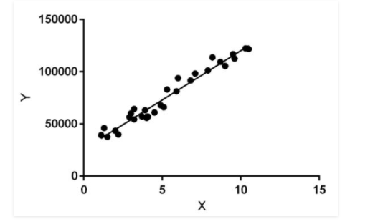
Linear Regression Diagram

Slide 10
Logistic Regression
Logistic regression is a supervised learning classification algorithm used to predict the probability of a target variable. The nature of target or dependent variable is dichotomous, which means there would be only two possible classes.
In simple words, the dependent variable is binary in nature having data coded as either 1 (stands for success/yes) or 0 (stands for failure/no).
Mathematically, a logistic regression model predicts P(Y=1) as a function of X. It is one of the simplest ML algorithms that can be used for various classification problems such as spam detection, Diabetes prediction, cancer detection etc.

Slide 11
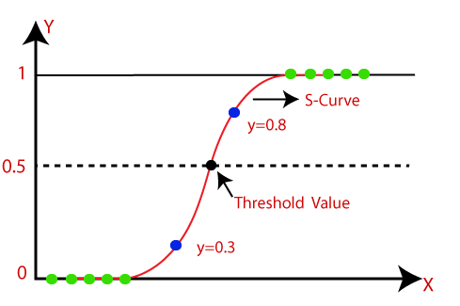
Logistic Regression diagram

Slide 12
Why are we using Logistic Regression
Here, for this project we are going to use logistical regression as the outcome here is either 1 or 0 or the patient has diabetes or does not have diabetes there is no in between

Slide 13

Implementation of the Project

Slide 14
Analysis of the data
We begin by first importing the necessary libraries, that are pandas, numpy, seaborn, matplotlib and sckitlearn.
Next after importing all the libraries we import in the dataset. our data stored in a CSV file called diabetes.csv. We first read our database in a pandas data frame called df, and then used the head () function to display the first 10 records in our database.
Next we make a number of plots using matplotlib and seaborn to analyse what the situation is and what are the parameters of the people who are susceptible to diabetes.
The plots are a count plot to check how many women have diabetes, bar graph to check the BMI range of people, hist plot to find out that which age group suffered with diabetes and last an axis plot to classify the relation b/w BP and diabetes.
The results were worrisome as a third of the patients suffered from diabetes , Majority of the population had a BMI over 30 or were obese and the patients having higher BP had diabetes .

Slide 15
Implementation of the algorithm and predicting
we are going to do is find the correlation of every pair of features (and the outcome variable), and visualize the correlations using a heatmap. Brighter colours indicate more correlation. As we can see from the table and the heatmap, glucose levels, age, BMI and number of pregnancies all have significant correlation with the outcome variable. We split the dataframe into 3 i.e train, test and check.
We began the training part since the model is readily available in sklearn, the training process is quite easy, and we can do it in few lines of code. First, we create an instance called Diabetes_Check and then use the fit function to train the model.

Slide 16
Implementation of the algorithm and predicting (cont)
We get accuracy as 78 percent .
Next is the testing part , we start by importing joblib and then similarly like training we implement it as well
With training and testing over we can start predicting part . We will now use our unused data to see how predictions can be made. We have our unused data in Check dataframe.
We will now use the first record to make our prediction. We will implement it with a few lines of code

Slide 17
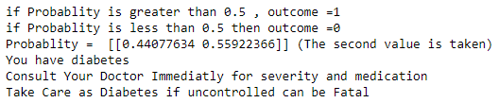
Output
On implementing we get the output as .

Slide 18
Conclusions
From the out put we can see that the patient is suffering from diabetes and needs to consult the doctor immediately and start her medication .
The model has an accuracy of 78 percent so there is a chance that she might not be having but 78 percent is a big number so she should at least consult the doctor asap and find out more.

Slide 19

Thank You

